Slide 1


CS 6831 Designing Secure Cryptography
Tom Ristenpart

Slide 2
Bilinear pairings
Useful algebraic structure relating two (or three) groups
Originally: converting discrete log in ECC groups to discrete log in related finite fields
[Menezes, Okamato, Vanstone 1993]
Cryptographic uses pioneered around turn of century
Three-party Diffie-Hellman key exchange [Joux 2000]
El Gamal variant [Verheul 2001]
Identity-based encryption [Boneh-Franklin 2001]
BLS short signatures [Boneh-Lynn-Shacham 2001]
…

Slide 3
Bilinear pairings
Let
be three groups of prime order p . Let g and h be generators of
is a function called the (bilinear) pairing
Bilinear: e(gª, h^{b}) = e(g,h)^{ab}
Non-degenerate: e(g,h) is a generator of G_{T}
Efficient to compute
Type 1: G₁ $=$ G₂ (built from supersingular elliptic curve G₁ , g = h
Symmetric pairing

Slide 4

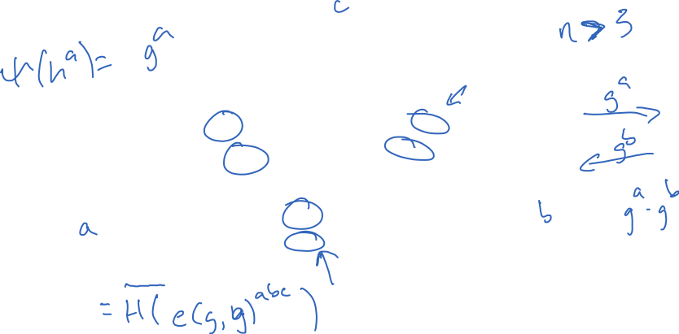
Three-party Diffie-Hellman
K = H( e(gª,g^{b})^{c} )
gª
g^{b}
g^{c}
g^{c}
gª
g^{b}
K = H( e(g^{b},g^{c})ª )
K = H( e(gª,g^{c})^{b} )

Slide 5
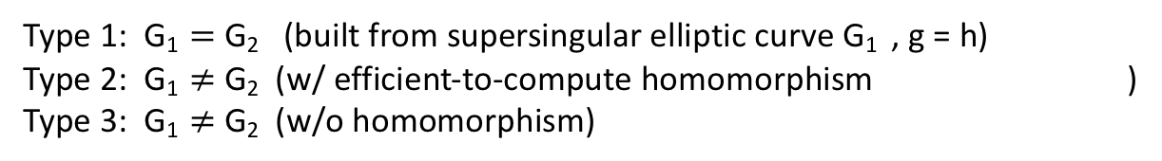
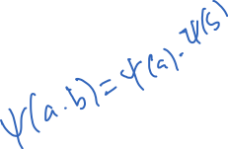
Bilinear pairings
Let
be three groups of prime order p . Let g and h be generators of
is a function called the (bilinear) pairing
Bilinear: e(gª, h^{b}) = e(g,h)^{ab}
Non-degenerate: e(g,h) is a generator of G_{T}
Efficient to compute
Type 1: G₁ $=$ G₂ (built from supersingular elliptic curve G₁ , g = h)
Type 2: G₁ $≠$ G₂ (w/ efficient-to-compute homomorphism )
Type 3: G₁ $≠$ G₂ (w/o homomorphism)
Symmetric pairing
Asymmetric pairings
Barreto-Naerhig (BN) elliptic curve construction supports Type 2 pairings:
G₁ is (special) elliptic curve over F_{p} for 254-bit prime p
G₂ is subgroup of elliptic curve over F
G_{T} is subgroup of F*
k = 12 is called the embedding degree
p¹²
p¹²

Slide 6
Discrete log in pairing-friendly groups
Let
be three groups of prime order p . Let g and h be generators of
is a function called the (bilinear) pairing w/ e(gª, h^{b}) = e(g,h)^{ab}
Let g_{T} = e(g,h)
Discrete log in G₁ (or G₂ ) no harder than discrete log in G_{T}
Security level | DLP in finite field (log p) | ECC group size (log q)
80 | 1024 | 160
112 | 2048 | 224
128 | 3072 | 256
256 | 15360 | 512
DLog(G₁ , g, X):
X’ <- e(X,h)
x <- DLog(G_{T} , g_{T} , X’)
Return x
k = 12 is called the embedding degree

Slide 7
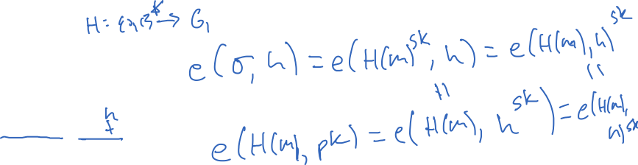
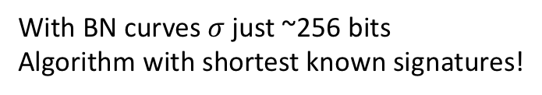
BLS short signatures
Let
be three groups of prime order p . Let g and h be generators of
is a function called the (bilinear) pairing w/ e(gª, h^{b}) = e(g,h)^{ab}
Let g_{T} = e(g,h)
A FDH-style hash algorithm
sk is random exponent from Z_{p}
pk = h^{sk}
With BN curves$σ$ just ~256 bits
Algorithm with shortest known signatures!

Slide 8
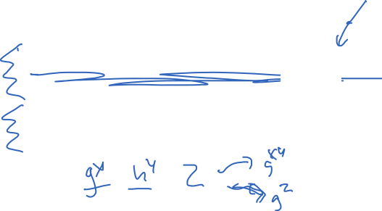
BLS short signatures
Let
be three groups of prime order p . Let g and h be generators of
is a function called the (bilinear) pairing w/ e(gª, h^{b}) = e(g,h)^{ab}
Let g_{T} = e(g,h)
A FDH-style hash algorithm
sk is random exponent from Z_{p}
pk = h^{sk}
Assumption | Given from G₁ | Given from G₂ | Challenge
(co-)CDH | g^{x} | h^{y} | Compute g^{xy}
(co-)DDH | g^{x} | h^{y} | Distinguish g^{xy} from random value in G₁
Bilinear CDH (BCDH) | g^{x} | h^{y} , h^{z} | Compute e(g,h)^{xyz}
Bilinear DDH (BDDH) | g^{x} | h^{y} , h^{z} | Distinguish e(g,h)^{xyz} from random value in G_{T}
With BN curves$σ$ just ~256 bits
Algorithm with shortest known signatures!
Gap Diffie-Hellman: CDH hard, DDH easy

Slide 9
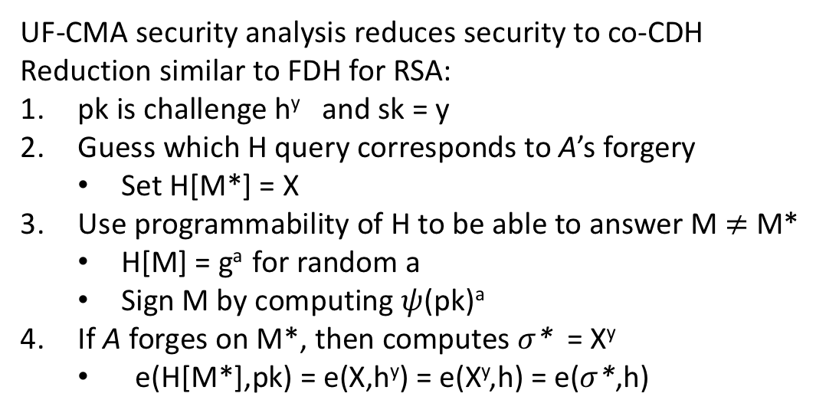

BLS short signatures
UF-CMA security analysis reduces security to co-CDH
Reduction similar to FDH for RSA:
pk is challenge h^{y} and sk = y
Guess which H query corresponds to A’s forgery
Set H[M*] = X
Use programmability of H to be able to answer M $≠$ M*
H[M] = gª for random a
Sign M by computing $ψ$(pk)ª
If A forges on M*, then computes $σ$* = X^{y}
e(H[M*],pk) = e(X,h^{y}) = e(X^{y},h) = e($σ$*,h)
Assumption | Given from G₁ | Given from G₂ | Challenge
(co-)CDH | g^{x} | h^{y} | Compute g^{xy}

Slide 10
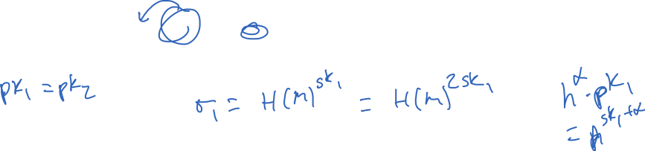
BLS multisignatures
BLS signatures easy to convert to multisignatures
Multiple parties sign same message
(pk₁,sk₁) , … , (pk_{m},sk_{m})
All m parties want to sign same message M
Verification easy:
Must be careful about rogue key attacks: adversary picking public key as function of another pk
Need to prove ownership of secret key when registering. See [Ristenpart, Yilek 2007]
Notes:
pk₂ = pk₁ then: sigma = (H(M)^{sk1})² is valid multisignature

Slide 11

Identity-based encryption
First suggested by Shamir 1984
Use identifiers for recipients instead of public keys
Hopefully simplifies PKI
Boneh-Franklin showed first good IBE scheme based on pairings
bob@mail.com
C
M

Slide 12
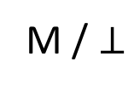
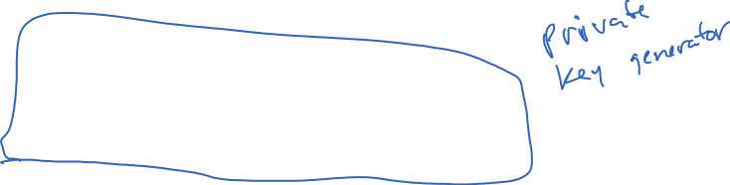
Identity-based encryption
master key generation
pg
kg
id
msk
sk_{id}
mpk
id is arbitrary string
id
enc
dec
C
sk_{id}
M / $⊥$
M
C
pg generates master public key / master secret key
kg generates identity-specific secret keys

Slide 13
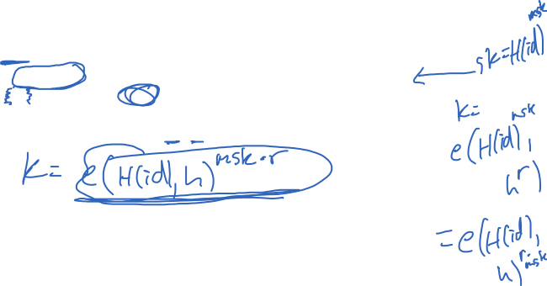
Boneh-Franklin scheme
Let
be three groups of prime order p . Let g and h be generators of
is a function called the (bilinear) pairing w/ e(gª, h^{b}) = e(g,h)^{ab}
Let g_{T} = e(g,h)

Slide 14

Boneh-Franklin scheme
Let
be three groups of prime order p . Let g and h be generators of
is a function called the (bilinear) pairing w/ e(gª, h^{b}) = e(g,h)^{ab}
Let g_{T} = e(g,h)
Assumption | Given from G₁ | Given from G₂ | Challenge
(co-)CDH | g^{x} | h^{y} | Compute g^{xy}
Bilinear CDH (BCDH) | g^{x} | h^{y} , h^{z} | Compute e(g,h)^{xyz}
Bilinear DDH (BDDH) | g^{x} | h^{y} , h^{z} | Distinguish e(g,h)^{xyz} from random value in G_{T}

Slide 15
IND-ID-CPA
Can’t learn anything about messages given:
Chosen message attack
Secret keys of any non-challenge ID

Slide 16
IND-ID-CPA
Can’t learn anything about messages given:
Chosen message attack
Secret keys of any non-challenge ID
Intuition for Boneh-Franklin proof:
Adversary can’t compute sk for id*
Same intuition as UF-CMA of BLS signatures
Enc for fixed id* is IND-CPA public-key encryption
A can’t compute e(H(id*)^{r},mpk) from h^{msk}, h^{r}, H(id*) without solving BCDH
Assumption | Given from G₁ | Given from G₂ | Challenge
Bilinear CDH (BCDH) | g^{x} | h^{y} , h^{z} | Compute e(g,h)^{xyz}

Slide 17
IBE secure against CCAs
Let
be three groups of prime order p . Let g and h be generators of
is a function called the (bilinear) pairing w/ e(gª, h^{b}) = e(g,h)^{ab}
Let g_{T} = e(g,h)
Can use Fujisaki-Okamoto transform: converts IND-CPA scheme to IND-CCA scheme
Originally for PKE, but works for IBE as well
Key idea: hybrid encryption with KEM randomness generated via RO
IBE.enc( mpk, id, K_{dem} ; H’’(K_{dem} ,M) ) AE(K_{dem} , M )
Decryption should recompute IBE.enc and check that it yields IBE ciphertext

Slide 18

IBE Variants
Heirarchical IBE
Identities are vectors (id₁,…,id_{m})
Derive below you in identity tree:
Ex: having secret key for (id₁,id₂) allows deriving (id₁,id₂,id₃) for any id₃
Fuzzy IBE
Encrypt under one vector, decrypt with secret key of “close” vector
Attribute-based encryption
Encrypt with set of attributes
Secret key decrypts any ciphertext whose attributes satisfy a predicate

